Slide 1
Kerberos

Slide 2
Its an authentication server whose function is to authenticate users to server and servers to users
Two versions of kerberos are commonly in use version 4 and version 5
Version 4 is widely used.Version 5 corrects some of the security deficiencies of version 4

Slide 3
Kerberos Version 4
Version 4 makes use of DES,to provide the authentication service
Important aspects of Version4 are
1.Simple Authentication Dialogue
2.More Secure Authentication Dialogue

Slide 4
Simple Authentication Dialogue
  In an unprotected n/w,any client can apply to any server
  Inorder to provide more security or to avoid the involvement of opponent, unauthorized privileges on server, an authentication server(AS) is used
  AS knows the passwords of all users and stores it in a database
  In addition,AS share a unique secret key with each server

Slide 5
C->AS IDc||Pc||IDv
AS->C Ticket
C->V IDc||Ticket
Ticket=Ekv[IDc||ADc||IDv]
Where
C=Client
AS=Authentication Server
V=Server
IDc=Identifier of user on C
IDv=Identifier of V
Pc=Password of user on C
ADc=Network address of C
Kv=secret key shared by AS and V

Slide 6
Here user logs on to a workstation and requests access to server V
AS
IDc Pc IDv
Ticket
C
Ticket V IDc
V
Ticket

Slide 7
Client sends a msg to AS that includes the users ID, servers ID and password
AS checks its database to find whether the user is authentic or not by checking the password
If test is passed, then AS accepts the user as authentic and convince the server that the user is authentic
AS creates a ticket that contains the user ID and n/w addr and server ID
This ticket is encrypted using the secret key shared by AS and the server
Ticket is then sent back to C

Slide 8
Since the ticket is encrypted ,it cannot be altered by C or by an opponent
With this ticket,C can now apply to ‘V’ for service.C sends a msg to ‘V’ containing C’s ID and the ticket
V decrypt the ticket and verifies that the user Id in the ticket is same as the unencrypted user Id in the msg
If these 2 matches, then the server considers the user authenticated and grant the requested service
IDc is included in the ticket to indicate that this ticket has been issued on behalf of C

Slide 9
A More Secure Authentication Dialogue
There are 2 pblms with a simple authentication dialogue concept
1.The no: of times a user has to enter a password
ie Each time when the user wants to logon,he should enter the password everytime
2.Plaintext transmission of password
So an opponent could capture the password and use any service accessible
To solve these problems,we introduce a scheme for avoiding plaintext passwords and a new server known as the ticket granting server(TGS)

Slide 10
Once per user logon session:
1.C->AS IDc//IDtgs
2.AS->C Ekc[Tickettgs]
Once per type of service:
3.C->TGS IDc//IDv//Ticket tgs
4.TGS->C TicketV
Once per service session:
5.C->V IDc//TicketV
Ticket tgs=EK tgs[IDc//ADc//Idtgs//Ts1//Lifetime1]
Ticket V=Ekv[Idc//ADc//Idv//TS2//Lifetime2]

Slide 11
The new user TGS issues tickets to users who have been authenticated to AS.Thus the first user requests a ticket granting ticket(Ticket tgs) from the AS
Steps
1.Client requests a tgs ticket on behalf of the user by sending the users ID to the AS, together with the TGS ID, indicating a request to use the TGS service
2.AS responds with a ticket that is encrypted with a key derived from the users password
3.The client requests a service granting ticket on behalf of the user
4.The TGS decrypts the incoming ticket and verifies the success of decryption by the presence of its ID

Slide 12
5.Client requests access to a service on behalf of the user. The server authenticates by using the contents of the ticket
EKc->Encrypted key derived from the password

Slide 13
Problems of more secure authentication dialogue
  Lifetime problem->ie the ticket should have an accurate timing, otherwise there will be a chance of attack
  The identity or the authentication of the server is not proved to the client

Slide 14
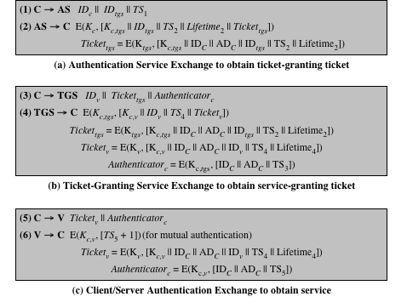
Version 4 msg Exchanges

Slide 15
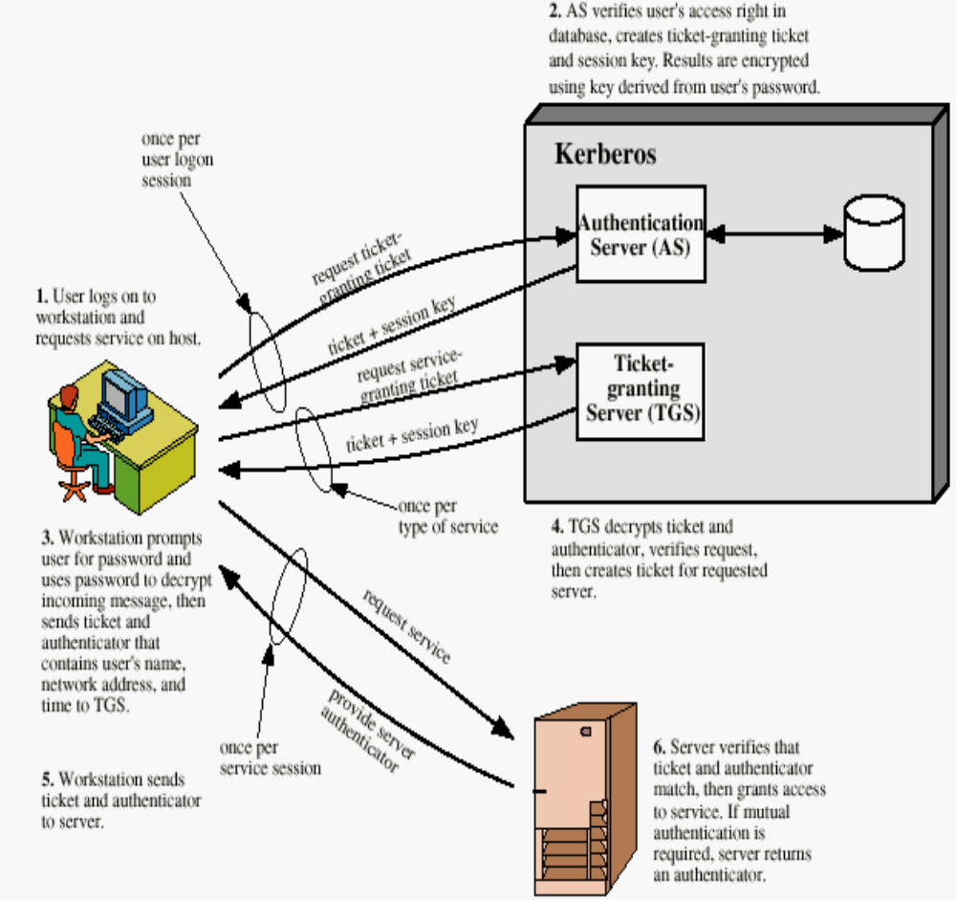

Slide 16
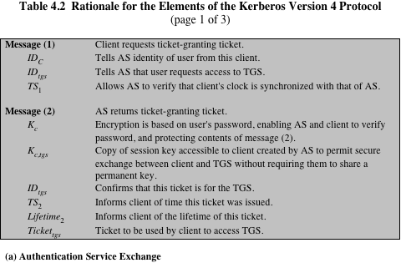

Slide 17
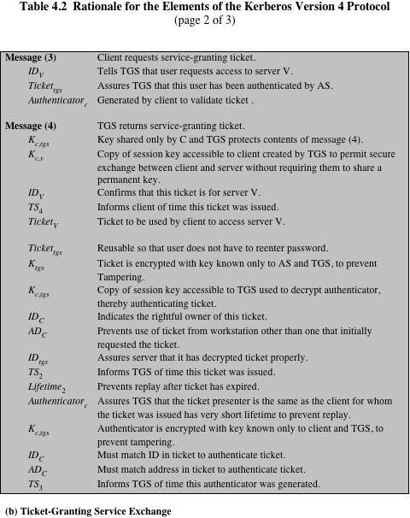

Slide 18
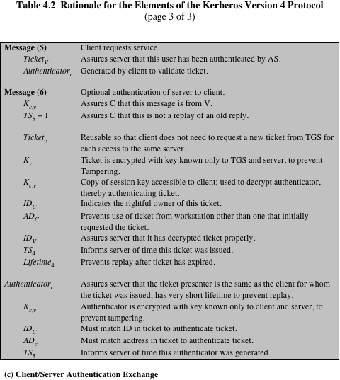

Slide 19
Kerberos Realms and Multiple Kerberos
A Kerberos environment consists of a Kerberos server, no: of clients and no: of application servers
Kerberos server must have user ID and password of all users in the database. All users are registered with Kerberos server
Kerberos server must share a secret key with each server. All servers are registered with Kerberos server
Such an environment ->Kerberos Realm
Kerberos realm is a set of managed nodes that share the same Kerberos database

Slide 20
Clients and servers under diff administrative organizations constitute diff realms
Users in one realm need access to servers in other realms and servers must be willing to provide service to users from other realms, provided users are authenticated
For two realms to support interrealm authentication
  Servers in each interoperating realm shares a secret key with server in other realm

Slide 21
A user wishing service on a server in another realm needs a ticket for that server:
1.Request ticket for local TGS
2.AS send the ticket for local TGS
3.Request ticket for remote TGS
4.Local TGS send the ticket of remote
5.Request ticket for remote server
6.Remote TGS send the ticket of remote server
7.Request for remote server

Slide 22
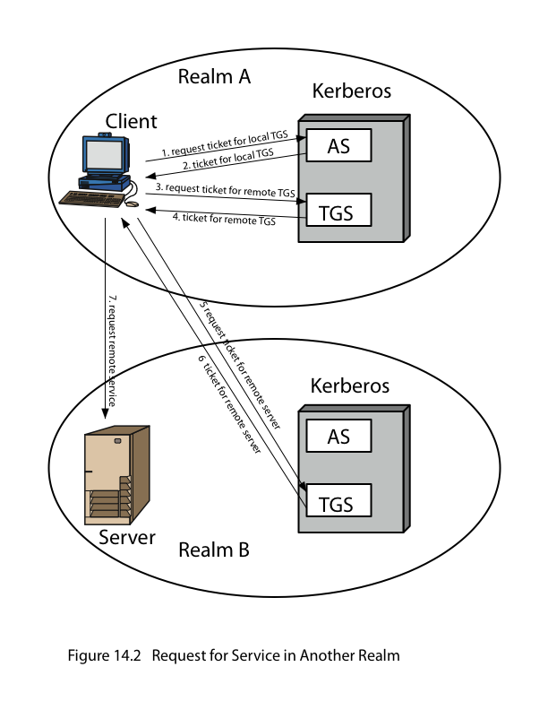

Slide 23
Drawback:
It does not scale well to many realms.
If there are N realms, then there must be N(N-1)/2secure key exchanges so that each Kerberos realm can interoperate with all other Kerberos realms

Slide 24
Steps
1.C->AS: IDc||IDtgs||TS1
2.AS->C: Ekc[Kc,tgs||IDtgs||TS2||Lifetime2||Tickettgs]
3.C->TGS: IDtgsrem||Tickettgs||AuthenticatorC
4.TGS->C: Ekc,tgs[Kc,tgsrem||Idtgsrem||TS4||Tickettgsrem]
5.C->TGSrem IDvrem||Tickettgsrem||AuthenticatorC
6.TGS->C Ekc,tgsrem[Kc,vrem||Idvrem||TS6||Ticketvrem]
7.C->Vrem Ticketvrem||AuthenticatorC

Slide 25
Kerberos Version 5
Version 5 provides a no: of improvements on version4 in 2 areas(Difference between version4 and version5)
1.Enviromental shortcomings
2.Technical deficiencies
Environmental Shortcomings
1.Encryption system dependence:
V4requires the use of DES
In V5;ciphertext is tagged with an encryption type identifier so that any encryption technique can be used

Slide 26
2.Internet protocol dependence
V4 requires the use of IP address
V5n/w address are tagged with type and length, allowing any n/w address
3.Msg byte Ordering:
In V4,the sender employs a byte ordering
In V5,all msg structures are defined using Abstract Syntax Notation(ASN.1) and BER which provide unambiguous byte ordering
4.Ticket Lifetime
Lifetime values in V4 are encoded in an 8bit quantity in units of 5mts
In V5,ticket include an explicit start time and end time

Slide 27
5.Authentication forwarding
V4 does not allow the services issued to one client to be forwarded to other host or client
But v5 provides this capability
6.Interrealm Authentication
In v4 interoperability among N realms require on the order of N² Kerberos to Kerberos relationships
V5 supports a method that requires fewer relationships

Slide 28
Technical Deficiencies
1.Double Encryption
In v4 tickets provided to the clients are encrypted twice, once with the secret key of the target server and with the secret key known to the client. The 2nd encryption is not necessary and is computationally wasteful
2.PCBC encryption
Encryption in version4 makes use of a non-standard mode of DES known as propagating cipher block chaining(PCBC)
PCBC is used to provide an integrity check as part of the encryption operation

Slide 29
3.Session Keys:
Each ticket includes a session key in V4
Since the same ticket may be used repeatedly to gain service, there is a risk that an opponent will replay msg’s from an old session to the client/server
In v5,a new access by the client would result in the use of a new subsession
4.Password Attacks:
Both versions are vulnerable to a password attack
But V5 provide a mechanism known as pre-authentication, which should make password attacks more difficult, but it does not prevent them

Slide 30
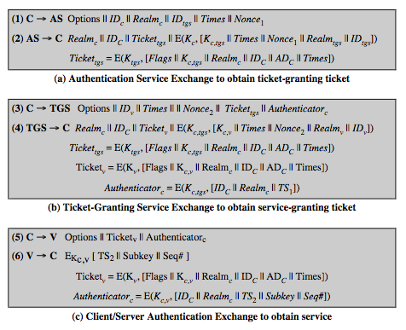
Version5 Message Exchanges

Slide 31
Realm->indicates realm of user
Options->Used to request that certain flags be set in the returned ticket
Times->Used by the client to request the following time settings in the ticket such as from,till,rtime
  From-start time
  Till-expiration time
  Rtime-renew-till time

Slide 32
Nonce-A random value to be repeated in msg to assure that the response is fresh and has not been replayed
Subkey-the clients choice for an encryption key to be used to protect a specific appln
Sequence no-Specifies the starting seq no: to detect replays

